Slide 1

HOW TO CREATE A CROSS PLATFORM NARRATED VERSION OF YOUR PRESENTATION

Slide 2
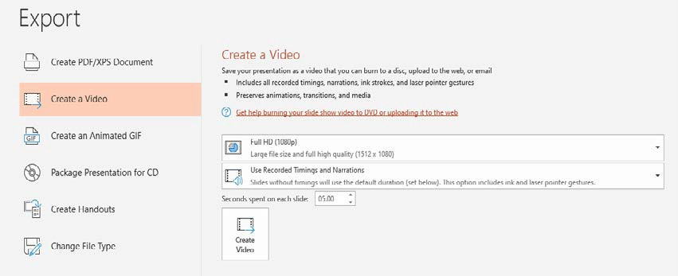
POWERPOINT WITH NARRATION
Please follow these steps to create, test and upload you narrated presentation:
Create your PowerPoint (as you usually would).
Within PowerPoint click the “File” Menu and Choose “Export”. You should see something similar to the image below:
The settings should be “Create a Video” (On the left) and then “Full HD (1080P)” and “Use Recorded Timings and Narrations”.
Click the “Create Video” button and save the file as an MP4 – Note: This will save in the same location as your presentation file and the process may take a few minutes, depending on the complexity of your slides. You will see a progress bar in the bottom right of your screen as the video is being encoded:
Using your computer’s microphone or headset microphone (headsets tend to provide higher sound quality), follow the directions on Microsoft’s support page [Link].
Make sure you to stop speaking your narration during every slide advance to avoid any loss of audio in your recording.
Once finished, test the file to ensure audio level quality and that the slides advance properly.
When the sound and timing are all set please Save this file under a new name and include the word Narrated in the file name (Please keep the file name to 30 characters or less) - Make sure to note where this file is saved on your computer.
Once the file is saved as an MP4, close out of PowerPoint and open the MP4 video on your computer. It should playback now as a video on your machine.
We are going to save the PowerPoint presentation as an MP4 video file. Please follow the instructions below. If your version of PowerPoint does not include this option. Please continue to the end of these instructions and upload the PowerPoint file itself to us and we will convert it.
Now, please login to the provided ProjectionNet upload site and upload this file to our presentation management system. The file will be available for viewing online exactly as it appears on your machine.
HOW TO CREATE A CROSS PLATFORM NARRATED VERSION OF YOUR PRESENTATION
01

Slide 3
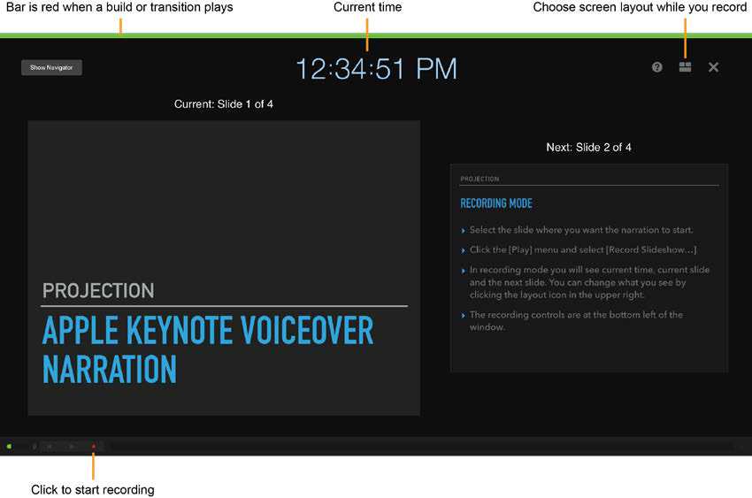
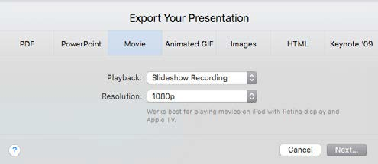
APPLE KEYNOTE WITH NARRATION
Please follow these steps to create, test and upload you narrated presentation:
Select the slide where you want the narration to start.
To start recording, click the [Red Circle] icon at the bottom of the window in the recording controls. The timer begins a 3 second countdown before recording starts.
Begin speaking into the microphone. You can pause recording by clicking the pause button at any time.
Advance to the next slide using the [Shift] + [Down Arrow]. Make sure you to stop speaking your narration during every slide advance to avoid any loss of audio in your recording.
Click the [Play] menu and select [Record Slideshow…].
In recording mode you will see current time, current slide and the next slide. You can change what you see by clicking the layout icon in the upper right.
The recording controls are at the bottom left of the window.
When you have finished recording click the [Red Circle] icon to stop recording.
Press the Escape [Esc] key or the [Exit] button in the upper left to save the recording and exit recording mode.
KEYNOTE RECORDING MODE SCREEN
To export your presentation to a movie file click the [File] menu and select [Export to] then [Movie]. Select Playback [Slideshow Recording] and Resolution [1080p] then export your presentation:
Now, please login to the provided ProjectionNet upload site and upload this file to our presentation management system. The file will be available for viewing online exactly as it appears on your machine.
NOTE: Adding a new slide to your presentation after recording narration will trigger an alert that the recording could be out of sync with the presentation. To delete a voiceover narration in a presentation, in the [Play] menu select [Clear Recording]. To delete your narration in recording mode click the [Trash Can] icon in the lower left.
HOW TO CREATE A CROSS PLATFORM NARRATED VERSION OF YOUR PRESENTATION
02

Slide 4
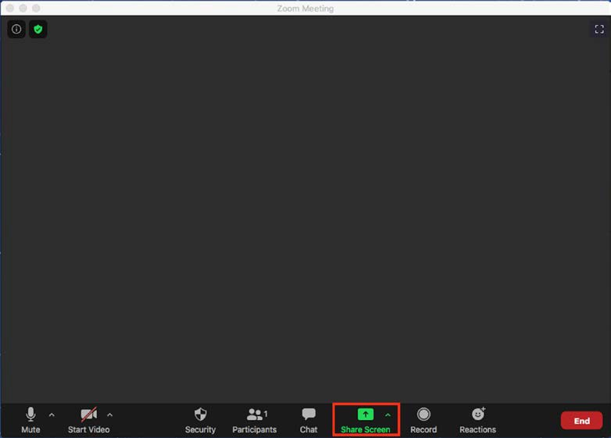
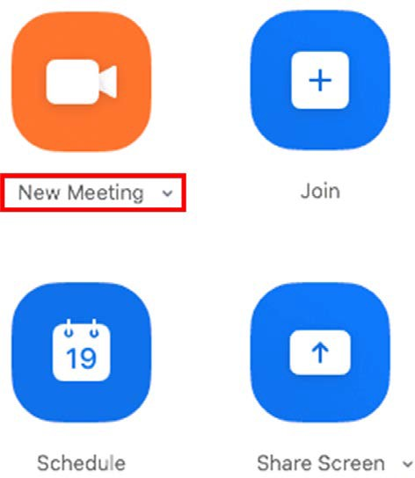
RECORDING YOUR PRESENTATION USING ZOOM
Open the Zoom Application.
Select “New Meeting”, you can choose to start the meeting/ recording with or without your camera by clicking on the arrow to access a pull down menu.
Click “Share Screen”.
Choose the screen you want to share.
Select your presentation on the screen in slideshow mode so it fills the screen.
You should get a pop-up window asking if you want to “Join with Computer Audio”, click Yes.
HOW TO CREATE A CROSS PLATFORM NARRATED VERSION OF YOUR PRESENTATION
03

Slide 5
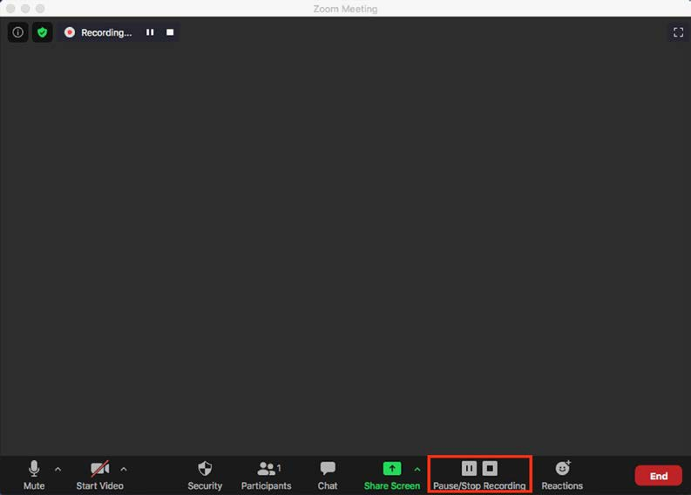
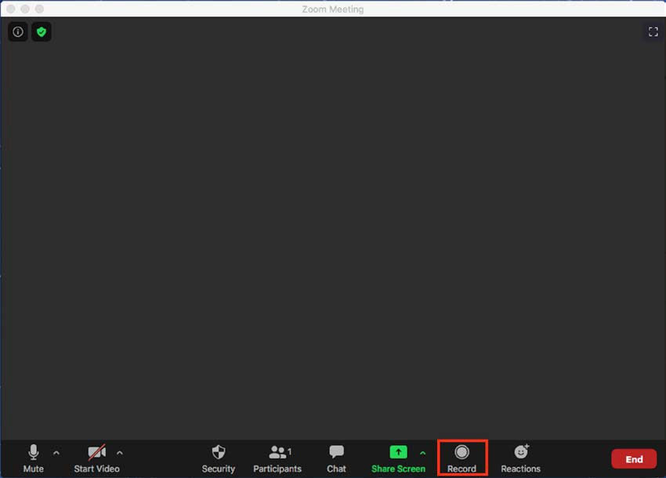
RECORDING YOUR PRESENTATION USING ZOOM Cont.
At the bottom right of the zoom window you should see a button marker “Record”. Click it and then select “Record on this Computer”
After you stop the recording, end the meeting and Zoom will create an MP4 video file for you to upload.
We recommend making a short test video and checking your results before recording your full presentation.
If you have another recording software you are familiar with please feel free to use it. The recording should be in MP4 format, with a resolution of 1920 X 1080.
You are now recording. You can pause and/or stop the recording with the buttons on the zoom window.
HOW TO CREATE A CROSS PLATFORM NARRATED VERSION OF YOUR PRESENTATION
04

Slide 6


